Slide 1
Time-Optimized Bayesian Optimization of Random Forest Hyperparameters
Gabriel Xu and Andrew Chen January 31, 2025
Dr. Yilmaz Period 5

Slide 2
Introduction
Addressing hyperparameter optimization for decision trees and random forests.
Challenge: Traditional tuning methods are inefficient and suboptimal.
Bayesian optimization has been used but suffers from hand-specified biases.
Our approach: Optimize both the random forest and Bayesian optimization hyperparameters.
Goal: Improve classification accuracy and efficiency.

Slide 3
Related Work
Grid search and random search
“Hyperparameter Optimization for Machine Learning Models Based on Bayesian Optimization” (Zhang et al., 2019)
Predict which hyperparameters are likely to work best
Gaussian process (GP) model, acquisition function
Manual parameters, number of initial sample points and the choice of the acquisition function
Garrido-Merchán & Jariego-Pérez (2021)
Predefined heuristics to switch through acquisition functions
Lindauer et al. (2019)
Tuning Bayesian Optimization hyperparameters significantly improve its efficiency and robustness
Our approach recursively tunes the hyperparameters of Bayesian Optimization

Slide 4
Dataset and Features
Dataset: breast-cancer.csv from Weka.
Contains clinical and histopathological data (e.g., tumor size, patient age, hormone receptor status).
Train-test split: 80%-20%, ensuring class balance.
Preprocessing: One-hot encoding for categorical features, discretization already applied to key variables.
No normalization needed due to categorical nature of data.

Slide 5
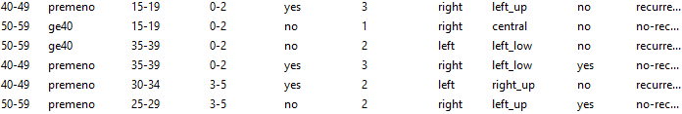
Dataset and Features

Slide 6
Methods
Random Forest Classifier
Ensemble learning: Multiple decision trees, majority voting for classification.
Helps reduce overfitting and improves accuracy.
Key hyperparameters: number of trees, tree depth, min samples per split, min samples per leaf.
Bayesian Optimization
Probabilistic model-based approach for hyperparameter tuning.
Uses Gaussian processes to model function and acquisition function for next hyperparameter choice.
More efficient than grid search or random search.

Slide 7
Methods
Three approaches compared:
Basic Random Forest – Hand-selected hyperparameters.
Bayesian Optimization – Optimized random forest hyperparameters.
Optimized Bayesian Optimization – Tuned Bayesian optimization hyperparameters recursively.
Optimizing Bayesian hyperparameters:
init_points: Number of initial test points.
n_iter: Number of iterations.
Trade-off between accuracy and runtime efficiency.

Slide 8
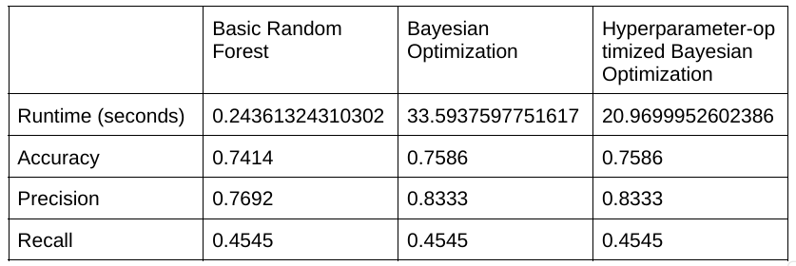
RESULTS

Slide 9
Results
Performance comparison:
Basic Random Forest: Accuracy = 0.7414, Precision = 0.7692, Recall = 0.4545, Runtime = 0.24s.
Bayesian Optimization: Accuracy = 0.7586, Precision = 0.8333, Recall = 0.4545, Runtime = 33.59s.
Optimized Bayesian Optimization: Same accuracy & precision, but faster runtime (20.97s).
Key finding: Optimization reduces computation time while maintaining performance.

Slide 10
Results - Confusion matrices
Basic Random Forest
[[33 3]
[12 10]]
Bayesian Optimization
[[34 2]
[12 10]]
Hyperparameter-optimized Bayesian Optimization
[[34 2]
[12 10]]

Slide 11
Results
Confusion Matrix Insights:
All models misclassified 12 recurrence cases → Low recall issue.
Bayesian optimization improved precision but did not enhance recall.
Takeaways:
Hyperparameter tuning can reduce runtime while maintaining accuracy.
More data could further improve model performance.
Future work: Investigate methods to enhance recall while keeping efficiency.

Slide 12
Conclusion/Future Work
Key Findings
Hyperparameter tuning can reduce runtime while maintaining accuracy
Meta-optimized Bayesian Optimization reduced execution time while maintaining performance
Both models struggled to improve recall
Future Directions
Test on larger, more diverse datasets for generalizability
Apply to other models (e.g., GBM, SVM)
Explore alternative surrogate models (e.g., TPE, neural networks).
Investigate methods to improve recall

Slide 13
References
Garrido-Merchán, E. C., & Jariego-Pérez, L. C. (2021). Towards automatic Bayesian optimization: A first step involving acquisition functions. Lecture Notes in Computer Science, 12882, 160–169. https://doi.org/10.1007/978-3-030-85713-4_16
Lindauer, M., Feurer, M., Eggensperger, K., Biedenkapp, A., & Hutter, F. (2019). Towards assessing the impact of Bayesian optimization’s own hyperparameters. Proceedings of the DSO Workshop at IJCAI 2019. arXiv:1908.06674. https://doi.org/10.48550/arXiv.1908.06674
Snoek, J., Larochelle, H., & Adams, R. P. (2012). Practical Bayesian optimization of machine learning algorithms. Advances in Neural Information Processing Systems, 25, 2951–2959. https://proceedings.neurips.cc/paper/2012/file/05311655a15b75fab86956663e1819cd-Paper.pdf
Thornton, C., Hutter, F., Hoos, H. H., & Leyton-Brown, K. (2013). Auto-WEKA: Combined selection and hyperparameter optimization of classification algorithms. Proceedings of the 19th ACM SIGKDD International Conference on Knowledge Discovery and Data Mining, 847–855. https://doi.org/10.1145/2487575.2487629
Zhang, Z., Li, M., Wang, Y., & Chen, W. (2019). Hyperparameter optimization for machine learning models based on Bayesian optimization. Journal of Computer Science and Technology, 34(3), 509–522. https://doi.org/10.1016/j.jcst.2019.03.002

Slide 14
Q/A

